Slide 1
ISSM Day3 worksheet
This activity involves a group discussion.
You are allowed to use AI tools for this discussion.

Slide 2
Team members
List your team members’ full names (as in your course registration)
Wang Mingyang A0331532R
Su Tanjia A0354250M
Fu Junchun A0353395W
Yan Yi A0333825A
Wang Zimo A0328948J

Slide 3
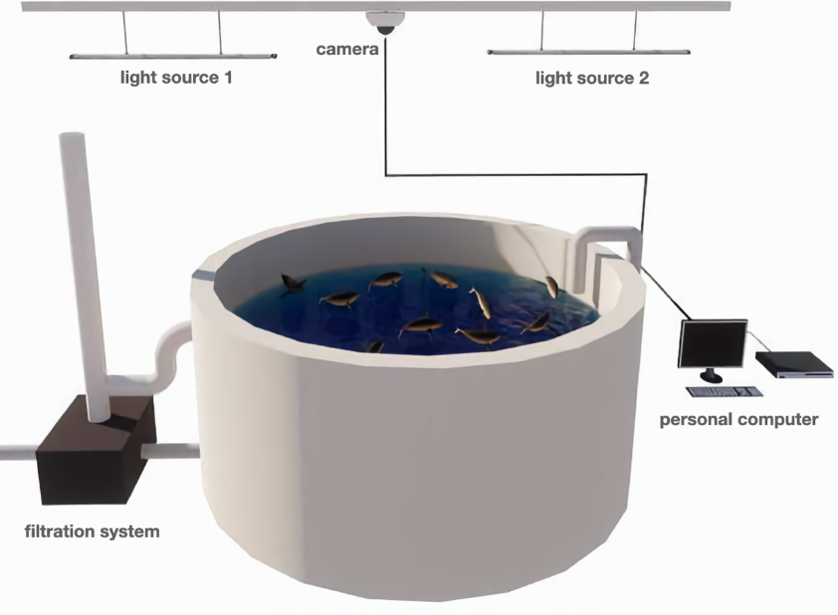
Case study
Use case: A smart fish tank monitoring system
Feeding is one of the key aspects of aquaculture and is an important factor in determining the profitability of aquaculture enterprises. Traditionally, the feeding amount is determined by fish farmers relying on their experience. However, this method is highly affected by the level of the worker’s expertise and is subjective and uncertain. To solve these problems, it is important to have automatic and precise control of the feeding amount. Currently, the assessment of fish appetite mainly deals with the information obtained from acoustic, optical, temperature, and oxygen level sensors, and establishes the relationship between the features of fish feeding behavior and fish appetite.

Slide 4
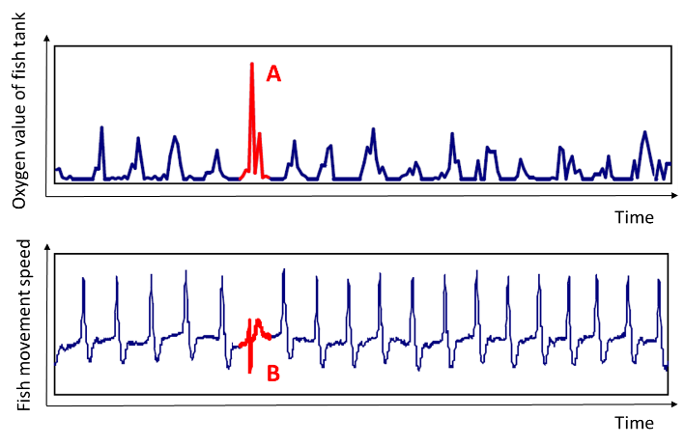
Question 1
To study the fish's feeding behavior, you have collected data, including oxygen measurements of the fish tank, which are taken every second. In addition, you have collected the fish motion speed that is measured by a computer vision-based solution. The fish motion speed is defined as the overall speed averaged by all fish in the unit of pixels per second. After you plotted these measurements over a long period, you noticed abnormal events (i.e., A and B) as highlighted in the Figure below. State the difference between these two anomaly events, A and B.
The plots of the oxygen measurements of the fish tank (top figure) and the fish motion speeds (bottom figure) over time.

Slide 5
Your answers to Question 1
Event A is an amplitude anomaly. At A, the oxygen measurement suddenly increases significantly and clearly exceeds the normal range of the oxygen signal. Therefore, this anomaly can be detected by examining the magnitude of an individual data point.
Event B is a temporal-pattern anomaly. At B, the fish motion-speed values do not necessarily exceed the normal value range, but the shape of this signal segment differs from the normal periodic movement pattern. Therefore, it cannot be detected by examining only a single data point; a sequence of measurements over a period of time must be analysed.
Event A means that “an individual value is abnormal,” whereas Event B means that “the pattern of a sequence of values is abnormal.”

Slide 6
Question 2
To identify each anomaly event A and B, would you use a time-domain signal processing method, a frequency-domain method, or a machine learning method? State your suggestion and explain the reason. If you choose the machine learning method, describe what data is needed for model training, and suggest one machine learning model.
 | Time-domain method | Frequency-domain method | Machine learning method
Event A | ✅
Event B |  |  | ✅ LSTM/RF/CNN

Slide 7
Your answers to Question 2
Event A : Choose time-domain method
A time-domain method is suitable for Event A because it is characterised by an unusually large amplitude in the oxygen measurement. A threshold can be determined from the mean and standard deviation of normal oxygen measurements. A value exceeding the upper threshold is identified as an anomaly.
Event B: Choose Machine-learning method
A machine-learning method is suitable for Event B because the anomaly is represented by an unusual temporal pattern rather than an extreme individual value. An LSTM autoencoder can be trained using fixed-length sequences of normal fish motion-speed measurements collected under different normal operating and feeding conditions. The model learns to reconstruct normal periodic patterns. A sequence with a reconstruction error above a selected threshold is identified as anomalous.

Slide 8
AI Tool Declaration
[Sample declaration copied from Canvas] The authors didn't use any AI tool. The authors used [AI tool name, e.g., GPT-5.1] to [describe specific uses: e.g., generate ideas, format paragraphs, improve expression, analyse effectiveness, create images and illustrations, produce drafts, refine, and/or finalise my assignment]. The authors are responsible for the content and quality of the submitted work.
[Provide your declaration here] The authors used Gemini to translate the English text. The authors are responsible for the content and quality of the submitted work.

